Slide 1
Optional English
Miss Valeria Barrera Alarcón
Social Comunicativo – Cultural Literario

Slide 2
English Language
The 3 most prevalent West Germanic languages are English, German, and Dutch.
West Germanic language that was first spoken in early medieval England.
official language of almost 60 sovereign states
United Kingdom
United States
Canada
Australia
Ireland
New Zealand

Slide 3
ENGLISH THROUGH TIME…
5th Century
15th Century
20th Century
11th Century
17th Century
Anglo-Saxon
Settlers brought
the English
Language to
Great Britain
With the introduction of the printing press to London early modern english began
The British Empire and the USA spread the english language around the world
With the Norman
Conquest of
England
middle english began
Through all types of printed and electronic media

Slide 4
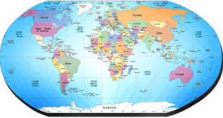
English Speaking Countries
London
Washington DC
Canberra

Slide 5
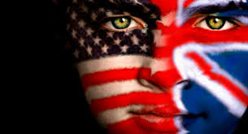
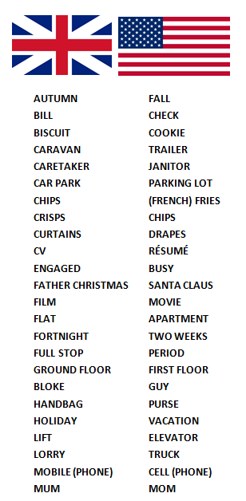
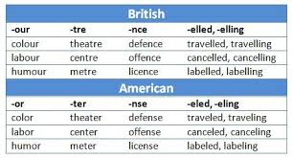
Difference between
the USA and the UK
SPELLING
VOCABULARY
R
T
PRONUNCIATION

Slide 6
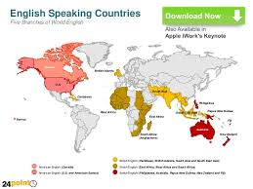
Importance of
Learning English
Global language
Official language in more than 45 countries and in other countries is the second language
Professional Career
4. Pleasure - travel

Slide 7
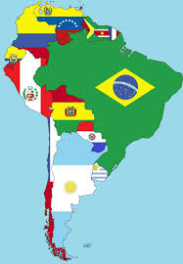
English in Chile
More than one thousand and five
hundred million people speak english
as a second language worldwide.
17.000.000 people
10% talk in english
1.700.000
Almost 17% of people between 15 and 29
3.000.000
understand and
speak english

Slide 8
